Slide 1





Category: Student Innovation
X
R1CodeFiesta
“Think outside the box, code inside the lines.”

Slide 2


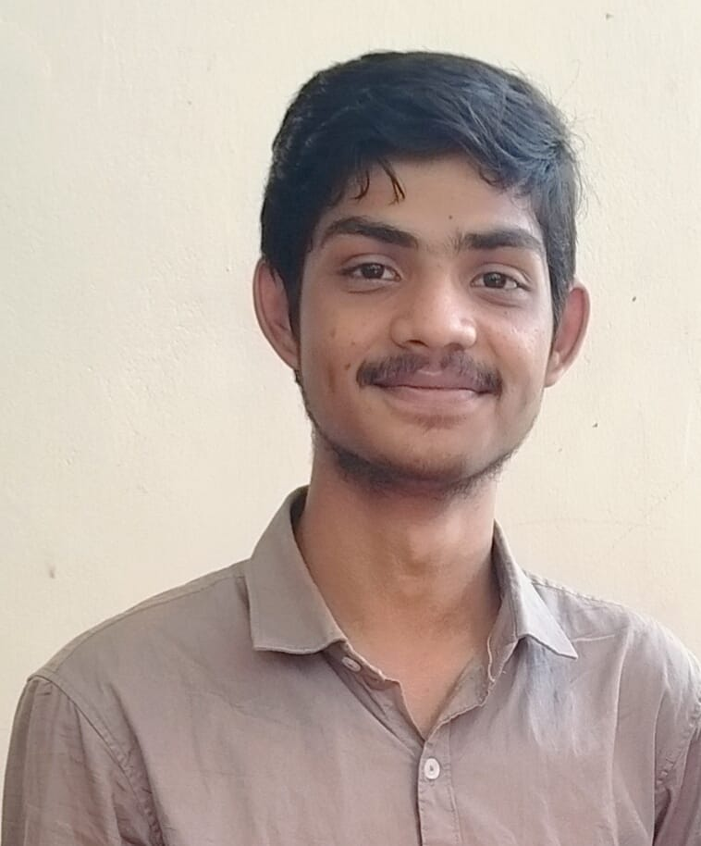


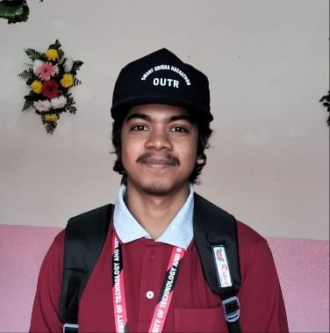
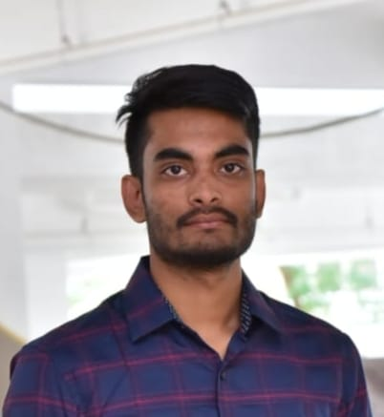
Team details
TEAM NAME: Team INFINITI
D.Likhitha
AVS Kaushik
College: ANITS, Visakhapatnam
Stream: CSE
Year of graduation: 2024
College: ANITS,Visakhapatnam
Stream: CSE
Year of graduation: 2024
B.Chaitanya
G.Akhil Venkat
Photo
College: ANITS,Visakhapatnam
Stream: CSE
Year of graduation: 2024
College: ANITS,Visakhapatnam
Stream: CSE
Year of graduation: 2024

Slide 3

PROBLEM STATEMENT
In this deep thoughts process of world we don’t know what thought/idea we may get at a moment. Who knows the idea may be competition next to international e commerce application Amazon or competition to a tesla.Even we innovate something we should need investment like water to a growing tree. We in the sense the young minds of entrepreneurs are finding tough for investors support or expert support. For that problem numerous intelligent ideas are going to vein without no reason. I felt very bad about it, then our team started surfing about this problem in internet such that if we find any efficient website on this basis. There is saying that “The entrepreneuring starts with daily life”. We didn’t find any dedicated platform on it. Then our exciting and interesting journey starts….
© TEAM INFINITI,2023. All rights reserved.

Slide 4
PROPOSED SOLUTION from our deep of hearts
Introducing “AIR UP” which is extracted from startup + AIR (which means online) when combined gives air up. where it acts like an interface between entrepreneur and the investor. We have given an dedicated re-search about 3 months on this aspect. After that we found all our website is unique .
This is an software based web application which has two sections in it further they divided into many subparts.
At first we discuss about top two layers:
1.Ideate Section
2.Invest Section
In Ideate section the young minds of world will create and submit their own ideas/innovations which are displayed for investors for the ease of investment.
In Investment section the investors will able to visit the ideas all over the world which are displayed on website which are submitted by entrepreneurs. (For Idea security purpose we are using patent system on various levels)
This is the basic idea of our startup. From this we enhanced our ideas and deployed few decent features which will be explained later.
© TEAM INFINITI,2023. All rights reserved.

Slide 5

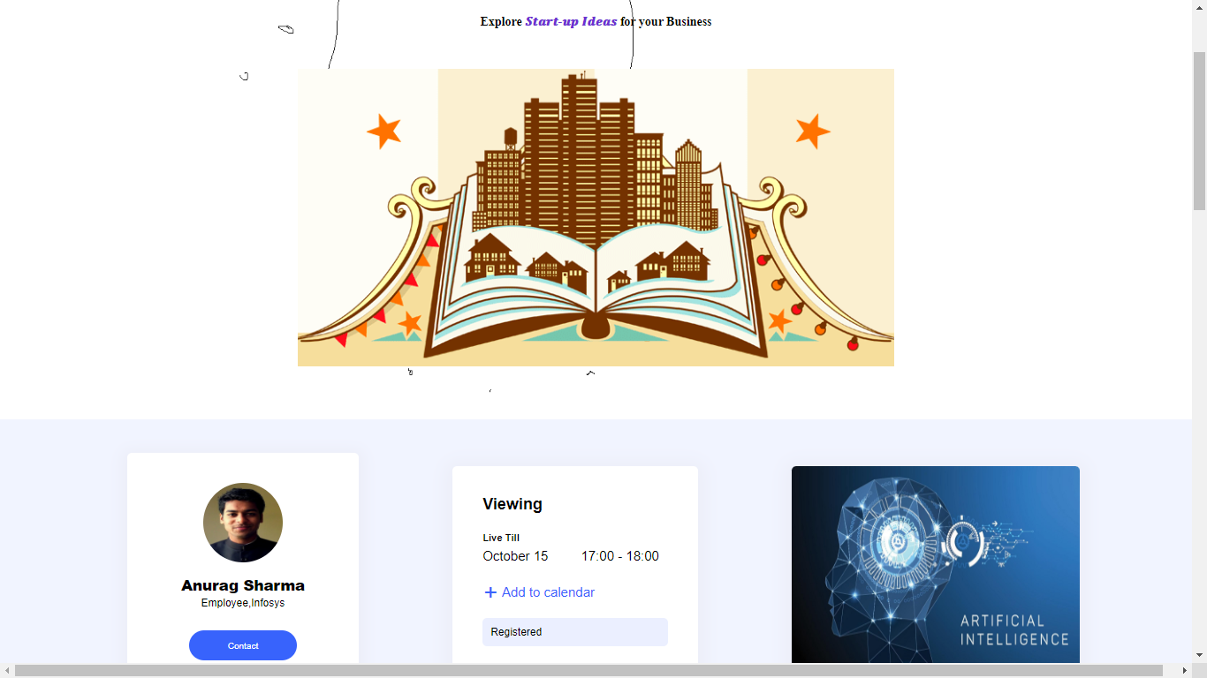
Sample Page of website:
*Just an sample actual website will be developed in further stages

Slide 6


Unique & Premium Features:
Key Features:
Acts as Medium between Entrepreneur and Investor.
Provisional Patent System available.
Ideas Auction system.
Razorpay Payment API.
Highly Protected Database.
Premium Features:
Idea Support from Air Up team and Investor side.
Developer Support from Air Up team.
Debt facility from Investor in order to level up the start-up.
Alert System available for Investor to suggest when to stop investing in that particular startup.
* T&C
© TEAM INFINITI,2023. All rights reserved.

Slide 7





Technologies used:
Technologies Used:
Stake Holders:
New startups
Student entrepreneurs
Angel Investors

Slide 8
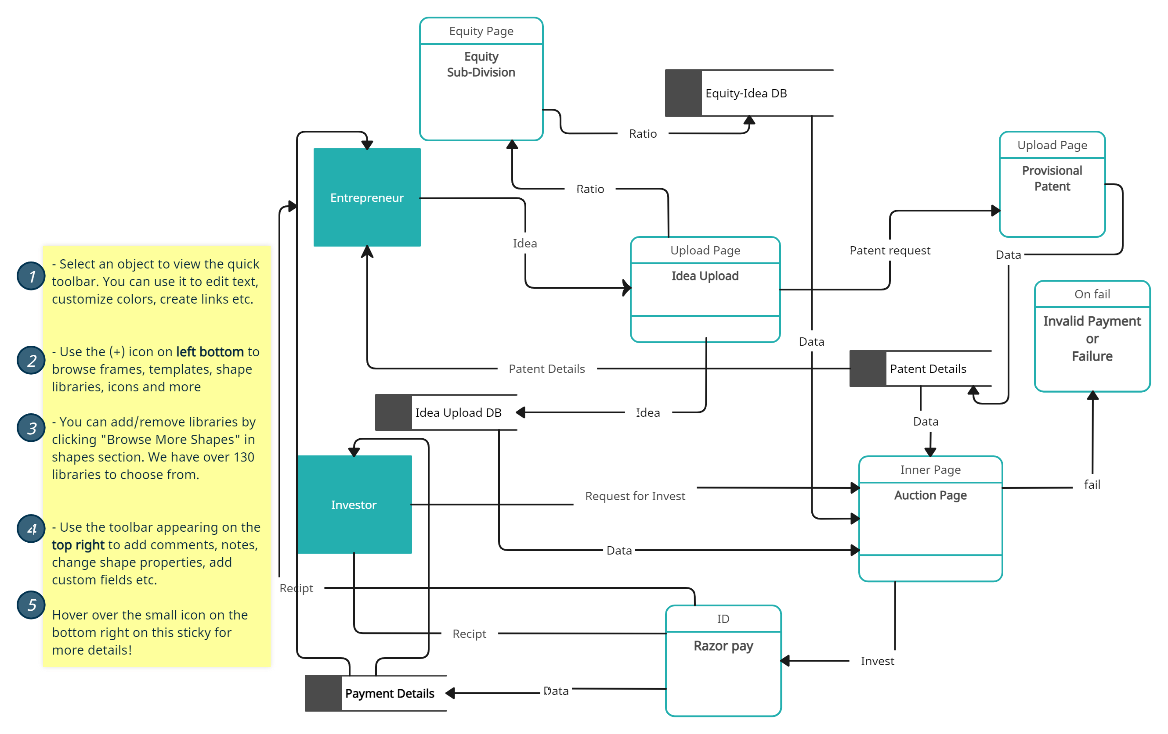
Data Flow Diagram:
© TEAM INFINITI,2023. All rights reserved.

Slide 9

Final Note:
As a final note we request you look into the start-up necessity . The only thing we need to say is not all startup win at a team. Every game has its own time to success and player in the market, this application gives you that time. Analyze all our given concepts deeply so that you may understand the actual purpose of the application.
Once think getting an early investment to your dream projects gives the best output. Let us together make INDIA developed in the Entrepreneurship and start up sector.
We think getting our application exposed from a Institute like you is our first step.
Let us give a chance we will take over then..

Slide 10
Thank You
Team INFINITI

